Slide 1
Lecture 12
Part 1: Lasers for Guide Stars
Claire Max
Astro 289, UC Santa Cruz
February 18, 2020

Slide 2
Outline of laser guide star topics
Why are laser guide stars needed?
Principles of laser scattering in the atmosphere
What is the sodium layer? How does it behave?
Physics of sodium atom excitation
Lasers used in astronomical laser guide star AO
Wavefront errors for laser guide star AO

Slide 3
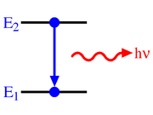
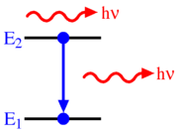
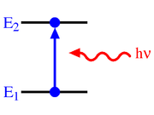
Atomic processes for two-level atom
Einstein, 1916: atom interacts with light in 3 ways
  Spontaneous emission
  Stimulated emission
  Absorption
Graphics credit: Wikipedia

Slide 4
Saturation effects in the Na layer, from Ed Kibblewhite
Consider a two level atom which initially has a ground state n containing N_{n} atoms and an empty upper state m. The atom is excited by a radiation field tuned to the transition
ν = E_{m}- E_{n}/h, hν >> kT
In equilibrium B_{nm} U(ν) N_{n} = A_{mn}N_{m} +B_{mn} U(ν) N_{m}
A_{mn} is Einstein's A coefficient (= 1/lifetime in upper state). B_{nm} = B_{mn} = Einstein’s B coefficient. U(ν) is the radiation density in units of Joules/cm³ Hz

Slide 5
Check units:
(cm³ Hz / erg) sec⁻¹
# atoms
B_{nm} U(ν) N_{n} = A_{mn} N_{m} + B_{mn} U(ν) N_{m}
ergs / cm³ Hz
sec⁻¹ per atom

Slide 6
Saturation, continued
Solve for N_{m} = N_{n} B_{nm} U(ν) / [ B_{nm} U(ν) + A_{mn}]
If we define the fraction of atoms in level m as f and the fraction in level n as ( 1 - f ) we can rewrite this equation as
f = B_{mn} U(ν) (1 - f ) / (B_{mn} U(ν) + A_{mn})
f = 1/[2 + A_{mn}/ B_{mn}U(ν)]
This equation shows that at low levels of radiation U(ν) the fraction of atoms in the upper level is B_{mn} U(ν) / A_{mn}
As the radiation density increases, fraction of atoms in upper level saturates to a maximum level of 1/2 for an infinite value of U (ν).
Define a saturation level as radiation field generating 1/2 this max:
U_{sat}(ν) = A_{mn}/2B_{mn}

Slide 7
U_{sat} is not a cliff: fraction in upper state keeps increasing for U >> U_{sat}
linear response to increased laser power

Slide 8
Saturation, continued
The ratio A_{mn}/B_{mn} is known from Planck's black body formula and is equal to 8πhν³/c³ joules cm⁻³ Hz
The intensity of the radiation field I ( ν) is related to U ( ν) by
I (ν) = U ( ν) c watts/cm² Hz
I_{sat} ≈ 9.48 mW/cm² for linearly polarized light
In terms of photons N_{sat} = a few x 10¹⁶ photons/sec.
CW (continuous wave) lasers produce more return/watt than pulsed lasers because of lower peak power

Slide 9
Outline of laser guide star topics
Why are laser guide stars needed?
Principles of laser scattering in the atmosphere
What is the sodium layer? How does it behave?
Physics of sodium atom excitation
Lasers used in astronomical laser guide star AO
Wavefront errors for laser guide star AO

Slide 10
Types of lasers: Outline
Principle of laser action
Lasers used for Rayleigh guide stars
Lasers used for sodium guide stars

Slide 11
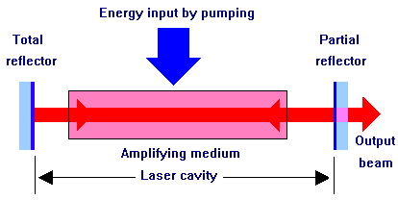
Overall layout (any kind of laser)

Slide 12
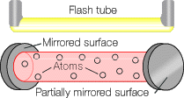
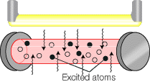
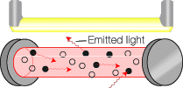


Principles of laser action
Stimulated emission
Mirror

Slide 13
Lasers used for Rayleigh guide stars
Rayleigh x-section ~ λ⁻⁴ ⇒ short wavelengths better
Commercial lasers are available
  Reliable, relatively inexpensive
  Green laser (532nm) – e.g. MMT
  RoboAO uses 10W ultraviolet (λ = 355nm) laser pulsed at 10 kHz
    Invisible to human eye.
    Unable to flash-blind pilots; Class 1 laser (incapable of producing damaging radiation levels during operation and exempt from any control measures).
    So no need for "laser spotters" as needed with Na lasers.

Slide 14
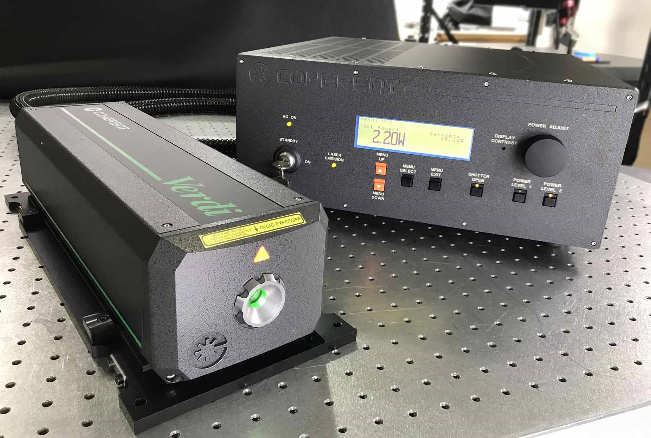
Example of laser for Rayleigh guide star: Frequency doubled Nd:YAG lasers
Nd:YAG means “neodimium-doped yttrium aluminum garnet”
Nd:YAG emits at 1.06 micron
Use nonlinear crystal to convert two 1.06 micron photons to one 0.53 micron photon (2 X frequency)
Example: Coherent’s Verdi laser
  Pump light: from laser diodes
  Very efficient
  Available up to 18 Watts

Slide 15
General comments on guide star lasers
Typical average powers of a few watts to 20 watts
  Much more powerful than typical laboratory lasers
Na guide stars - Class IV lasers (a laser safety category)
  “Significant eye hazards, with potentially devastating and permanent eye damage as a result of direct beam viewing”
  “Able to cut or burn skin”
  “May ignite combustible materials”
As a result, need to have interlocks on cabinets and doors, and avoid airplanes and satellites

Slide 16
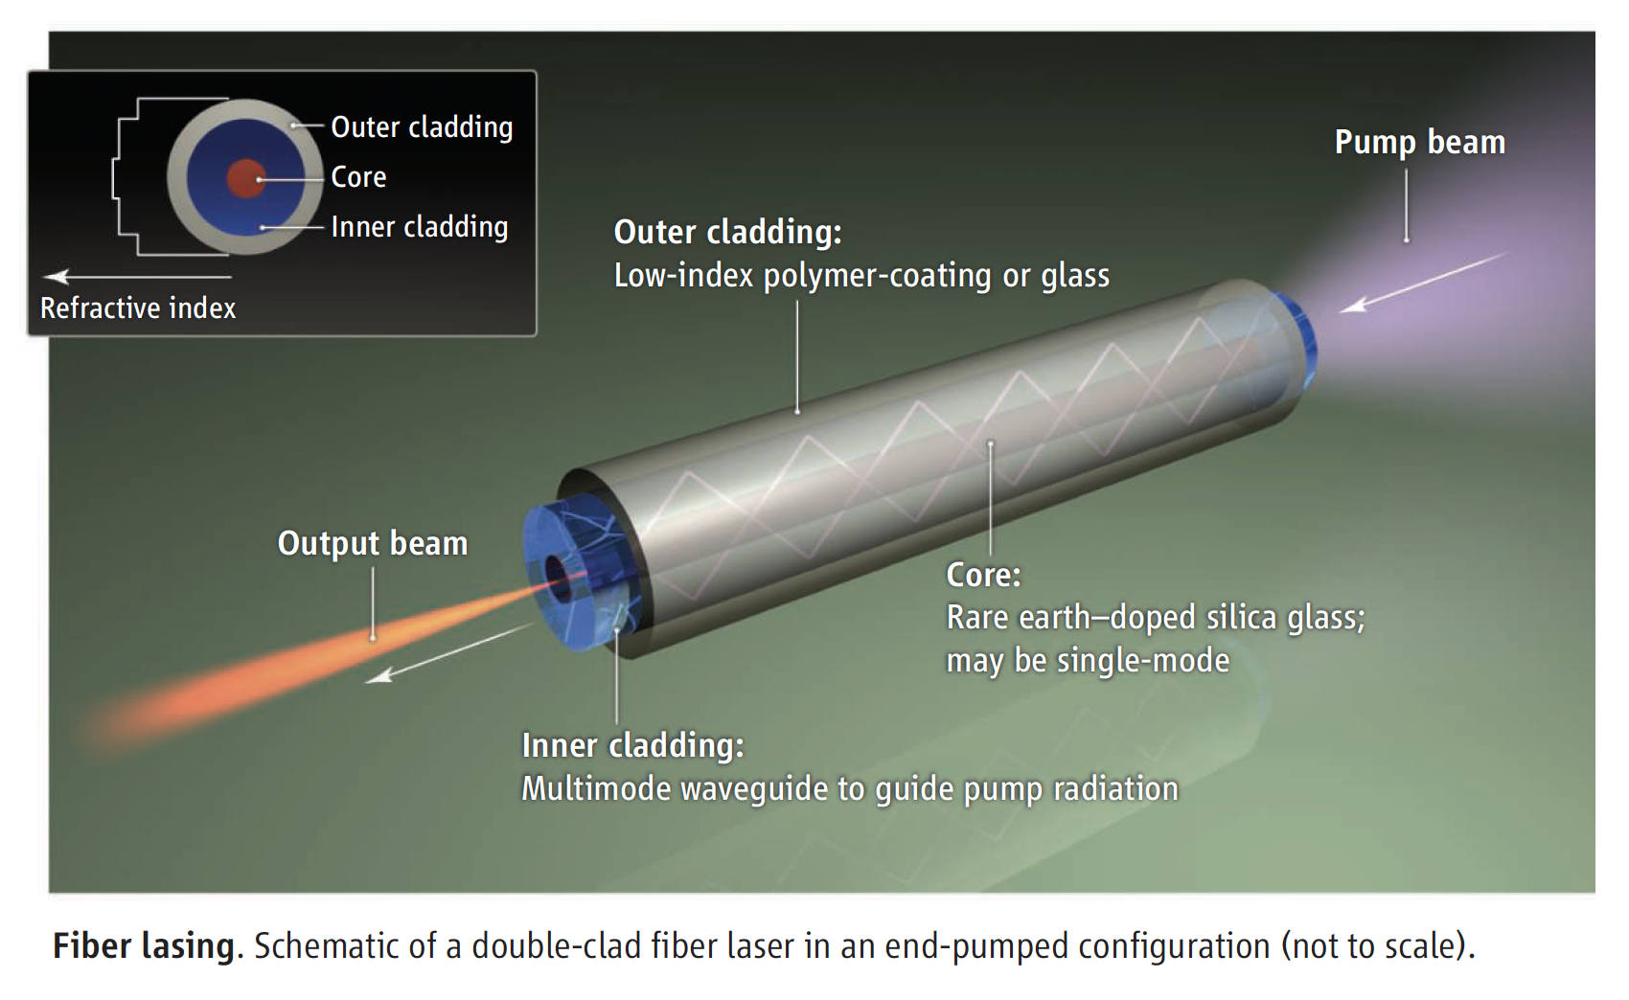
Pump light propagates through cladding, pumps doped fiber all along its length
Credit: Nilsson and Payne, Science Magazine, 2011

Slide 17
Procuring lasers for sodium guide stars
No known laser medium wants to lase directly at 589nm, the wavelength of the Na D₂ transition
To make 589nm light, have to make use of nonlinear processes in the lasing medium
  Raman scattering: shifts laser wavelength to a slightly longer one
  Frequency doubling: two photons at frequency 𝛖 interact nonlinearly in a nonlinear crystal to produce a photon at frequency 2𝛖
  Sum frequency mixing: 𝛖_{out} = 𝛖₁ + 𝛖₂ in a nonlinear crystal

Slide 18
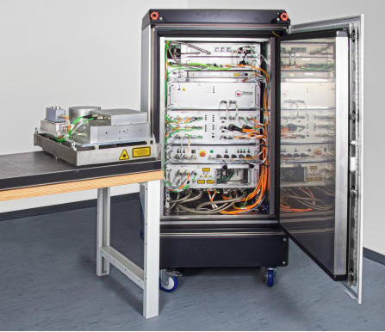
Toptica laser (concept developed by ESO)
Start with pump fiber laser at 1120 nm
Raman shift to longer wavelength -- 1178 nm
Then frequency-double to 589 nm
Fiber laser
Electronics and cooling
Keck Toptica Laser

Slide 19
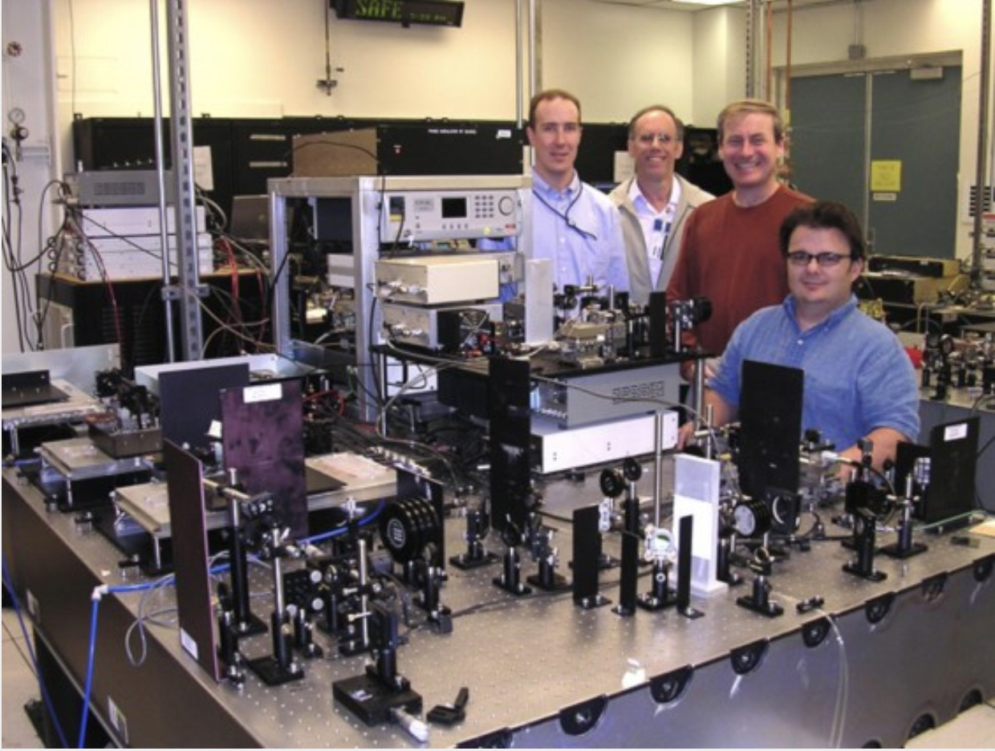
CfAO Fiber laser concept developed by Daren Dillon (UCSC) and Jay Dawson (LLNL)
Two separate fiber amplifiers, sum frequency mixing
One at 938 nm, one at 1583 nm

Slide 20
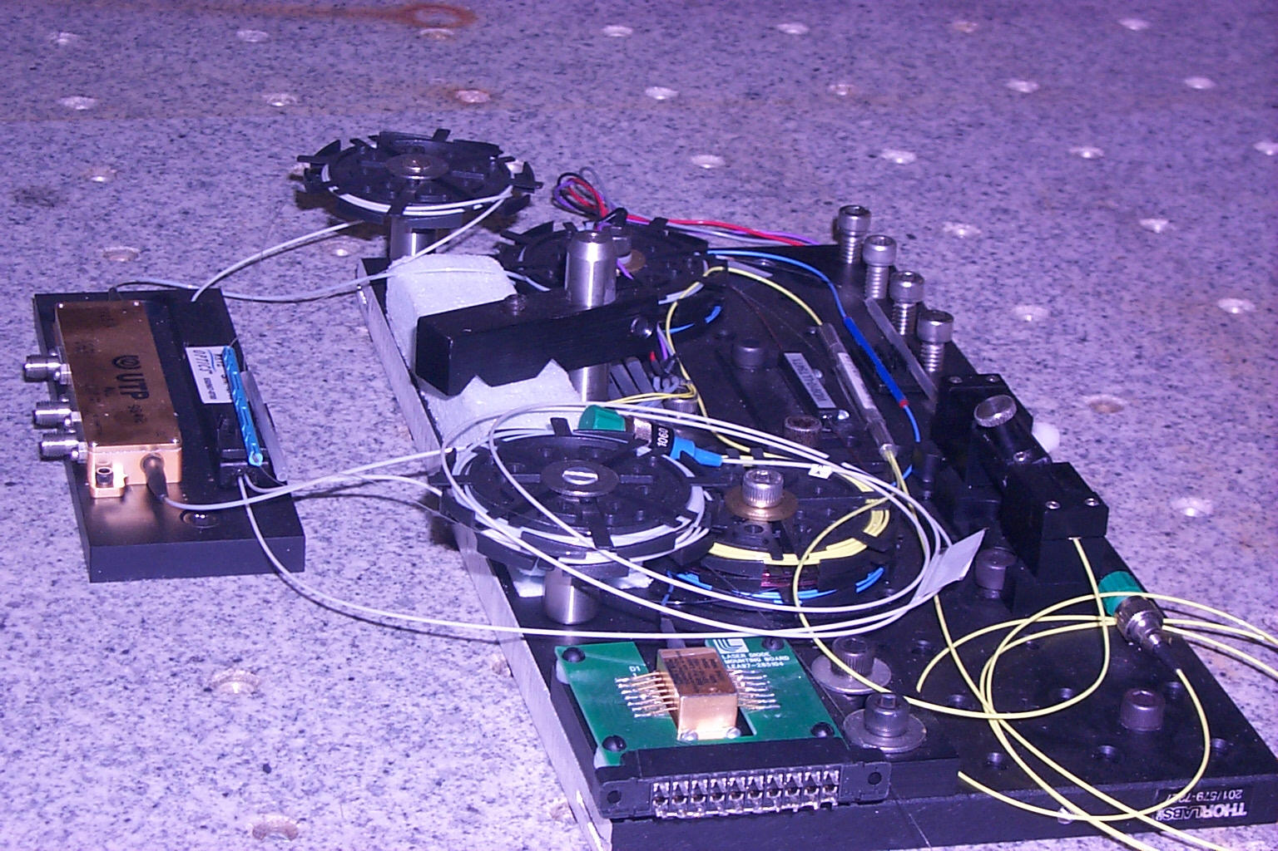
Current generation of Na lasers: all-fiber laser (Toptica, LLNL and UCSC)
Example of a fiber laser

Slide 21
Advantages of fiber lasers
Very compact
Commercial parts from telecommunications industry
Efficient:
  Pump with laser diodes - high efficiency
  The doped fiber is in the core
  Pump light goes thru fiber cladding all along its length - excellent surface to volume ratio
Two types of fiber lasers have been demonstrated at the required power levels at 589 nm (Toptica in Europe, Daren Dillon at UCSC plus Jay Dawson at LLNL)

Slide 22
Toptica fiber laser (ESO, Keck 2, Gemini)
Fiber laser
Electronics and cooling

Slide 23
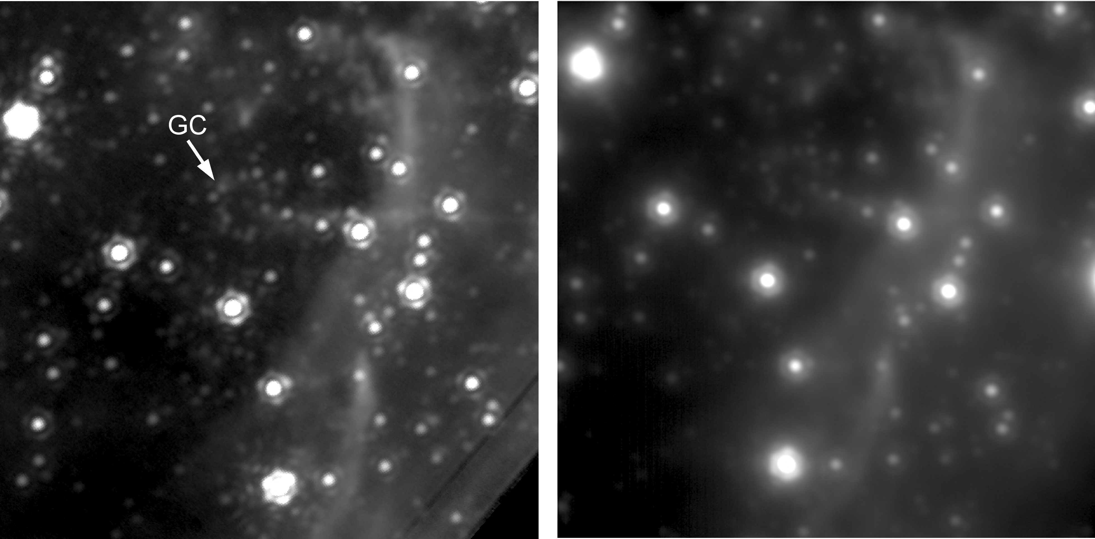
Galactic Center with Keck laser guide star AO
Keck laser guide star AO
Best natural guide star AO
Andrea Ghez, UCLA group

Slide 24
Outline of laser guide star topics
Why are laser guide stars needed?
Principles of laser scattering in the atmosphere
What is the sodium layer? How does it behave?
Physics of sodium atom excitation
Lasers used in astronomical laser guide star AO
Wavefront errors for laser guide star AO

Slide 25
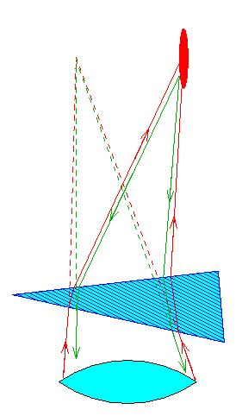
Laser guide star AO needs to use a faint tip-tilt star to stabilize laser spot on sky
from A. Tokovinin

Slide 26
Effective isoplanatic angle for image motion: “isokinetic angle”
Image motion is due to low order modes of turbulence
  Measurement is integrated over whole telescope aperture, so only modes with the largest wavelengths contribute (others are averaged out)
Low order modes change more slowly in both time and in angle on the sky
“Isokinetic angle”
  Analogue of isoplanatic angle, but for tip-tilt only
  Typical values in infrared: of order 1 arc min

Slide 27
Tip-tilt mirror and sensor configuration
Telescope
Deformable mirror
Tip-tilt mirror
Beam splitter
Wavefront sensor
Tip-tilt sensor
Beam splitter
Imaging camera

Slide 28
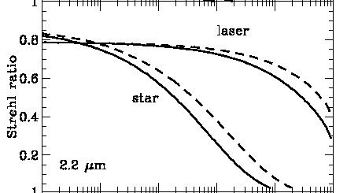

Sky coverage is determined by distribution of (faint) tip-tilt stars
Sky coverage fraction: probability that your favorite galaxy
will have a bright enough TT star nearby
1
Keck: >18th mag
Galactic latitude = 90°
Galactic latitude = 30°
Assumes:
271 deg of freedom
5 W cw laser
0
From Keck AO book

Slide 29
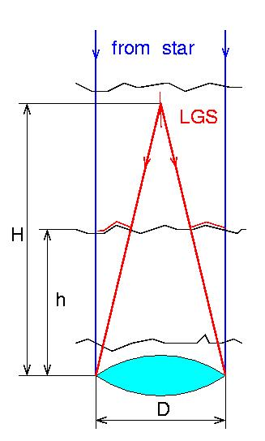
“Cone effect” or “focal anisoplanatism” for laser guide stars
“Real” star is at infinity, whereas laser is at finite height
Two contributions:
  Unsensed turbulence above height of guide star
  Geometrical effect of unsampled turbulence at edge of pupil
from A. Tokovinin

Slide 30
Cone effect, continued
Characterized by parameter d₀
Hardy Sect. 7.3.3 (cone effect = focal anisoplanatism)
σ_{FA}² = ( D / d₀)^{5/3}
Typical sizes of d₀ ~ a few meters to 20 meters

Slide 31
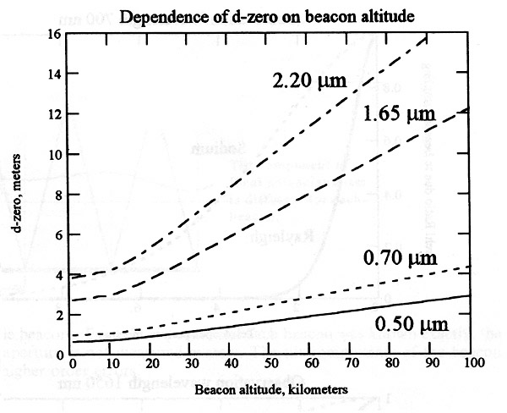
Dependence of d₀ on beacon altitude
from Hardy
One Rayleigh beacon OK for D < 4 m at λ = 1.65 micron
One Na beacon OK for D < 10 m at λ = 1.65 micron

Slide 32
Effects of laser guide star on overall AO error budget
The good news:
  Laser is brighter than your average natural guide star
    Reduces measurement error
  Can point it right at your target
    Reduces anisoplanatism
The bad news:
  Still have tilt anisoplanatism σ_{tilt}² = ( θ / θ_{tilt} )^{5/3}
  New: focus anisoplanatism σ_{FA}² = ( D / d₀ )^{5/3}
  Laser spot larger than NGS σ_{meas}² ~ ( 6.3 / SNR )²

Slide 33
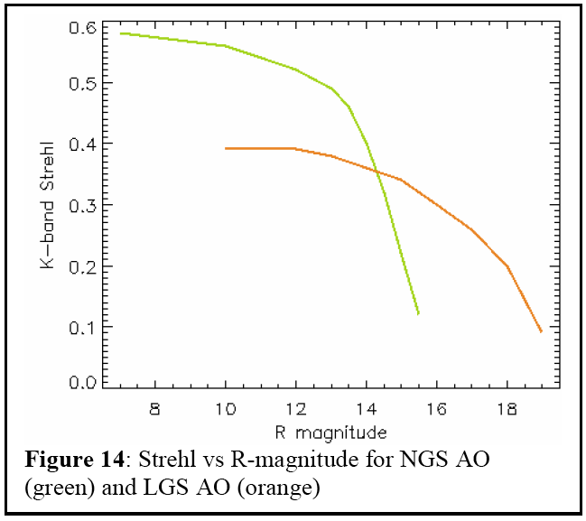
Compare NGS and LGS performance
Schematic, for visible tip-tilt star

Slide 34
Main Points
Rayleigh beacon lasers are straightforward to purchase, but single beacons are limited to medium sized telescopes due to focal anisoplanatism
  Can fix if you use multiple lasers
Sodium layer saturates at high peak laser powers, so try to use long pulses or “CW” (continuous wave) lasers
For Na guide stars, fiber lasers are the way to go (long pulses, low peak power)
Added contributions to error budget from LGS’s
  Tilt anisoplanatism, cone effect, larger spot

